Slide 1


Shrinking sea-urchins in a high CO₂ world: a two-phase experimental design
Kathy Ruggiero
Richard Jarrett
Proteomics and Biomedicine Group
School of Biological Sciences
CSIRO, Division of Mathematics, Informatics and Statistics
2 December 2009

Slide 2
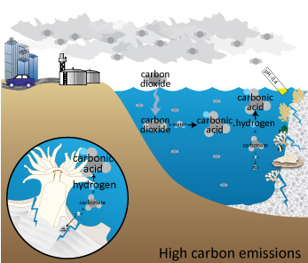
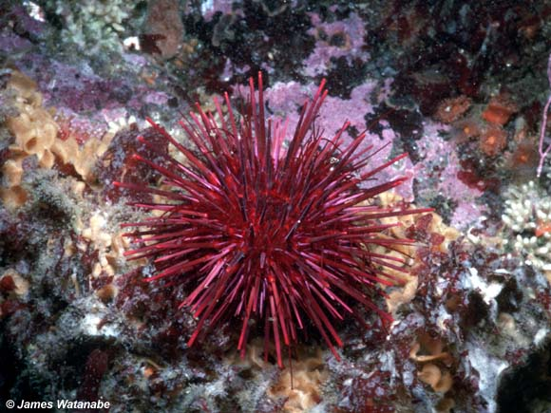
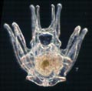
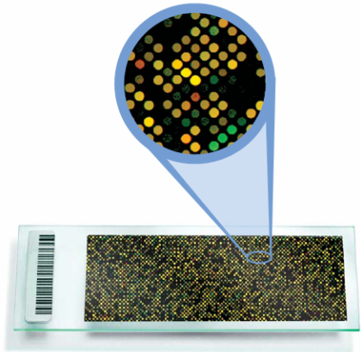
Walk with me…
Two experiments
Phase 1 Experiment: Simulate a high CO₂ world
Phase 2 Experiment: Measure gene expression

Slide 3
Global warming’s evil twin
Where does all the CO₂ go?
Some CO₂ remains in the atmosphere
Some is taken up by terrestrial plants
And, some is absorbed by seawater
Ocean pH
“Ocean acidification”
CO₂ absorption
Notes:
CO₂ and its sister chemical species, HCO₃– and CO₃ ^{2–} comprise the carbonate buffer system which regulates the pH of seawater
One of the consequences of this change in ocean chemistry is its impact on the caclification

Slide 4
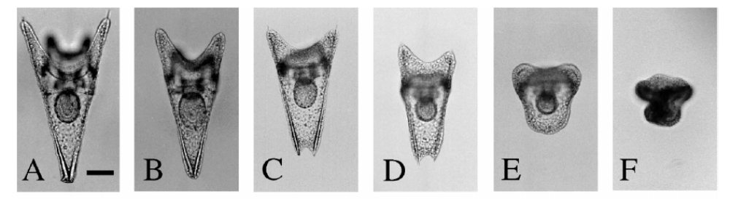
Effects of ocean acidification
Abnormal morphology
↓ ability to build shells and skeletal structures
Swimming, feeding and survival affected
Air
+ 500
+ 1000
+ 2000
+ 5000
+ 10000
CO₂ in ppm
Molecular mechanisms?

Slide 5
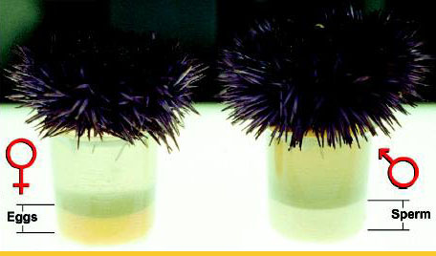
Phase 1 experiment
Where babies come from
http://weboflife.nasa.gov/images/urchin.jpg
Parent-pair

Slide 6
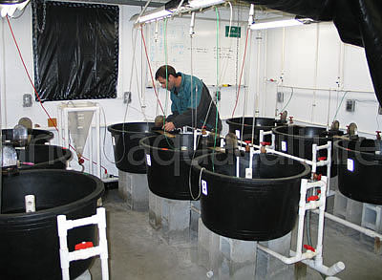

Phase 1 experiment
Different CO₂ worlds
15 ºC
Divide into 3 cultures
Control = 300ppm
(current level)
http://uncw.edu/aquaculture/images/Larval-rearing-tanks.jpg
Mid = 540 ppm
Until 4-arm stage
High = 970 ppm
http://www.ceoe.udel.edu/Antarctica/pluticon.jpg

Slide 7
Phase 1 experiment
…and warmer oceans
Split into 5 subsamples
Subjected to heat stress

Slide 8
Phase 1 experiment
…and warmer oceans
Split into 5 subsamples
Subject to heat stress
11ºC
15ºC
19ºC
21ºC
24ºC

Slide 9
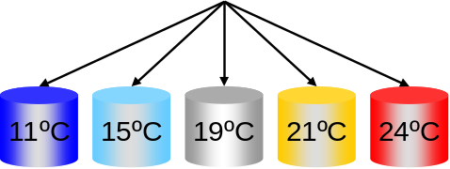
Phase 1 experiment
Design summary
x 4
Control
Mid
High
60 samples

Slide 10
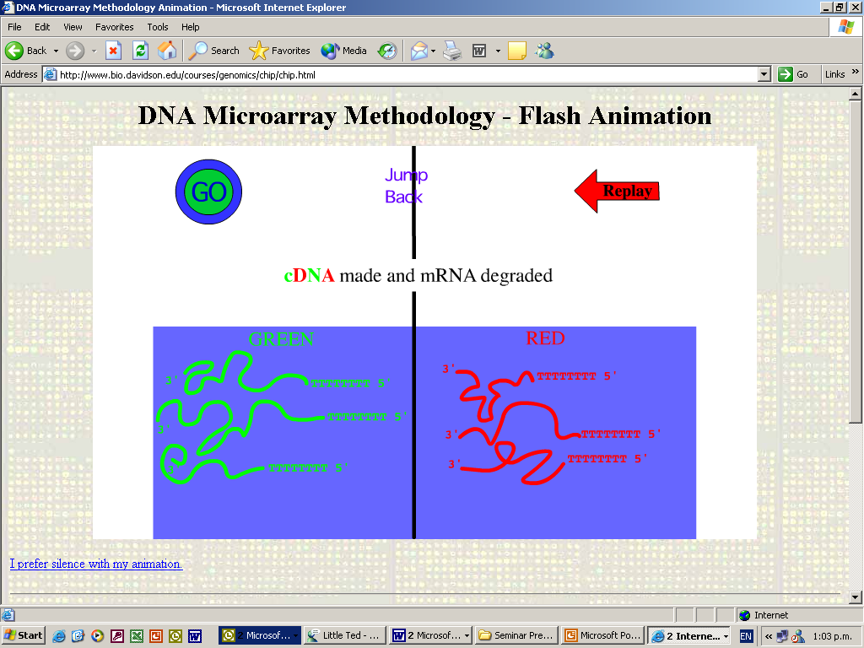
Phase 2 experiment
Measure gene expression
Mid
High
11ºC
15ºC

Slide 11
Phase 2 experiment
Measure gene expression
Mid
High
11ºC
15ºC

Slide 12
Phase 2 experiment
Measure gene expression
Mid
High
11ºC
15ºC

Slide 13

Phase 2 experiment
Measure gene expression
Mid
High
11ºC
15ºC

Slide 14
The dilemma
How to pair 60 samples on 30 arrays?
x 4
Control
Mid
High
60 samples

Slide 15
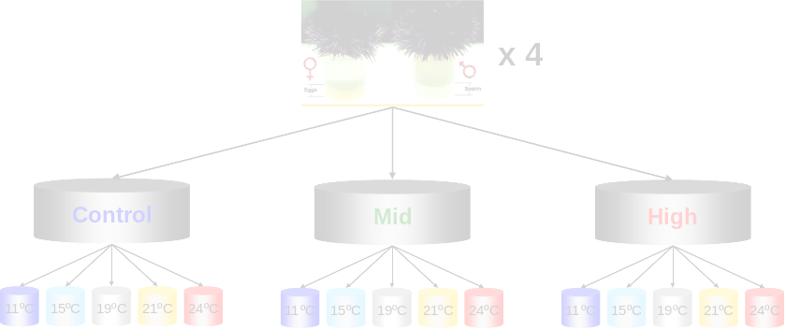



ANOVA table
Phase 1 design
Var Compts in EMS
Source
d.f.
Between Parent-pairs (PP)
3
CO₂
2
Residual
6
Between Cultures in PP
8
HST
4
HST.CO₂
8
Residual
36
Between Subsamples in Cultures in PP
48
Total (adj.)
59

Slide 16
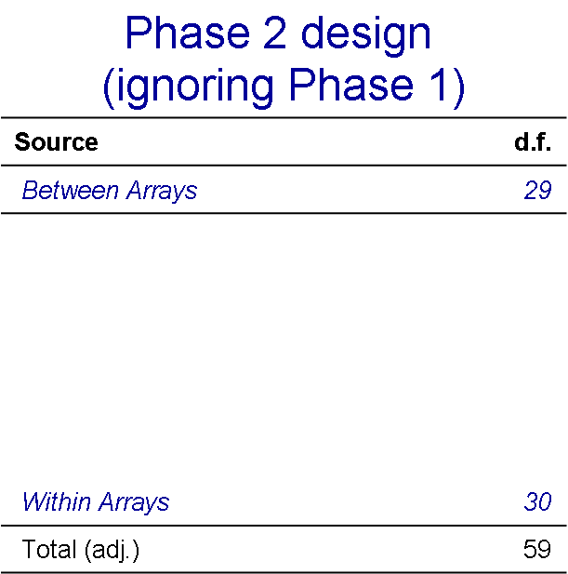
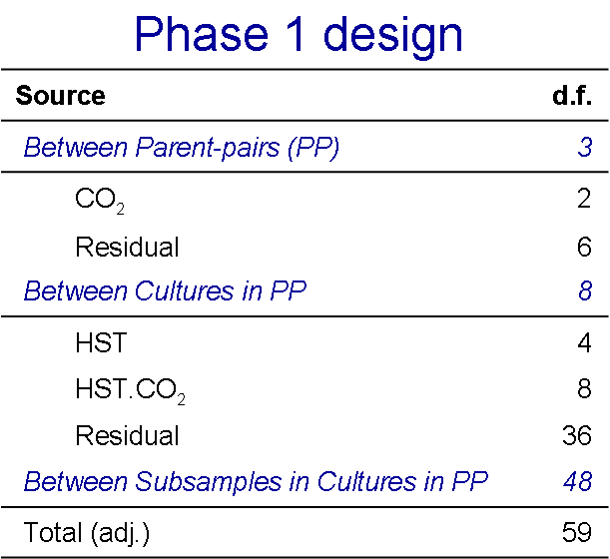
The challenge

Slide 17
Design considerations at Phase 2
“We are most interested in how the response to heat stress differs between CO₂ levels.”
CO₂ x HST at Phase 1
  Estimated between subsamples within cultures within parent pairs
  Want subsamples ⊥ arrays
    Only 2 samples per array
    So, in our dreams!

Slide 18
Design considerations at Phase 2
“We are most interested in how the response to heat stress differs between CO₂ levels.”
CO₂ x HST at Phase 1
  Estimated between subsamples within cultures within parent pairs
  Want subsamples ⊥ arrays (as much as possible)
  What if difference is between CO₂ levels?
    CO₂ main effect confounded with arrays
    Estimated with low precision
    Only 6 d.f. (at most from Phase 1) to estimate Between Cultures Expected Mean Square

Slide 19
Heat stressed samples → Arrays
Group arrays into 6 “sets” of 5
Set 1
Set 2
11
11
24
15
21
19
Loop 1
Loop 2
21
19
15
24
11
15
19
21
24
11
15
19
21
24
15
19
21
24
11
19
21
24
11
15

Slide 20
Heat stress samples → Arrays
Group arrays into 6 “sets” of 5
Balanced incomplete block design w.r.t. heat stress
11
11
24
15
21
19
Loop 1
Loop 2
21
19
15
24
11
15
19
21
24
11
15
19
21
24
15
19
21
24
11
19
21
24
11
15

Slide 21
6 sets of 5 arrays
Set of Arrays
Array
1
2
3
4
5
1
Loop 1
2
Loop 2
3
Loop 1
4
Loop 2
5
Loop 1
6
Loop 2

Slide 22
BIB design w.r.t. Parent-pair (PP)
Set of Arrays
Array
1
2
3
4
5
PP
CO₂
11
15
19
21
24
1
C
1
15
19
21
24
11
2
C
11
15
19
21
24
3
C
2
19
21
24
11
15
4
C
11
15
19
21
24
2
M
3
15
19
21
24
11
4
M
11
15
19
21
24
1
M
4
19
21
24
11
15
3
M
11
15
19
21
24
4
H
5
15
19
21
24
11
1
H
11
15
19
21
24
2
H
6
19
21
24
11
15
3
H

Slide 23



ANOVA table
Source
d.f.
Efficiency
Var Compts in EMS
CO₂
2
Parent-pairs
3
0.333
Between Sets
5
HST
4
0.375
HST.CO₂
8
0.375
Error
12
Between Arrays within Sets
24
Parent-pairs (1 vs 2, 3 vs 4)
2
0.667
Parent-pairs (1+2 vs 3+4)
1
0.556
Dye
1
0.111
HST
4
0.625
HST.CO₂
8
0.625
Error
15
Within Arrays
29
Total (adj.)
59

Slide 24
Design considerations at Phase 2
“We are most interested in how the response to heat stress differs between CO₂ levels.”
An alternative
  Consider CO₂ at Phase 1
  Estimated between cultures within parent pairs
  Want cultures ⊥ arrays (as much as possible)
  Confound parent pair (PP) with arrays
    Odd number of samples (15) per PP
    Must co-hybridize some samples from different PP

Slide 25
Two designs
Set of Arrays
Array
Design 1
Design 2
1
2
3
4
5
PP
CO₂
PP
CO₂
11
15
19
21
24
1
C
1
C
1
15
19
21
24
11
2
C
1
M
11
15
19
21
24
3
C
2
M
2
19
21
24
11
15
4
C
2
H
11
15
19
21
24
2
M
3
H
3
15
19
21
24
11
4
M
3
C
11
15
19
21
24
1
M
4
C
4
19
21
24
11
15
3
M
4
M
11
15
19
21
24
4
H
1
M
5
15
19
21
24
11
1
H
3
H
11
15
19
21
24
2
H
2
H
6
19
21
24
11
15
3
H
4
C

Slide 26
How do they compare?
Efficiencies
Effect
Design 1
Design 2
CO₂
1, but in top “stratum”
?
HST
0.625
0.428 - 0.594
CO₂.HST
0.625
0.307 - 0.428
Not canonical efficiencies, but based on efficiencies of particular chosen contrasts.

Slide 27
In closing…
Consider Phase 1 design when designing Phase 2 experiment
Construct EMS for each design
How do things change if Arrays are considered a random effect?
How do things change if we fit Cultures ignoring Arrays followed by Arrays eliminating cultures?
How do we do this in LIMMA?

Slide 28
Acknowledgements
Dr Mary Sewell (University of Auckland)
Prof Gretchen Hofmann (UC, Santa Barbara)
Dr Anne Todgham (San Francisco State University)

